Slide 1
SENN: Stock Ensemble-based Neural Network for Stock Market Prediction using Historical Stock Data and Sentiment Analysis
1st Louis Owen
Undergraduate Program in Mathematics
Faculty of Mathematics and Natural Sciences
Institut Teknologi Bandung
louisowen6@gmail.com
2nd Finny Oktariani
Combinatorial Mathematics Research Group
Faculty of Mathematics and Natural Sciences
Institut Teknologi Bandung
f.oktariani@math.itb.ac.id
Notes:
Okay thank you very much. It’s a pleasure to be here. My name is Louis Owen, at the time I am submitting this paper with my co-author Ms. Finny Oktariani, I am still a Mathematics undergraduate student at Institut Teknologi Bandung, and my co-author is my undergraduate thesis supervisor. Earlier in mid-July, I was just graduated from my university and now I am already get my Bachelor of Science title. For the acknowledgement, our paper will not be ready without the amazing and valuable support from my other lecturers, Mr. Wono Setya Budhi and Mr. Fajar Yuliawan.
So, today I am going to talk about combining the power of historical stock data, the wisdom of crowds, and the advance of deep learning, to predict the stock price in the future.

Slide 2

The Wisdom of Crowds
Photo by Antenna on Unsplash
Notes:
Nowadays, almost all of us has at least a social media account. Sometimes we use it to tell how’s our day going on, what are our latest achievements, what topic of discussion that keep buzzing in our head and felt like it has to be spread to our community in order to get feedback from them, OR… it can also be a platform for us and others to discuss or give opinion about a particular topic.
Specifically, for the stock market-related social media, this platform quite reflects the Wisdom of Crowd theory, which refers to the idea that large groups of people are collectively smarter than individual experts.

Slide 3

Stock Market Prediction
Photo by Markus Spiske on Unsplash
Notes:
What if we can exploit the data provided from social media as an add-ons to our existing stock market prediction model? Isn’t it wonderful to get direct opinion from the driver of stock market movement?

Slide 4

Advancement of Deep Learning
Photo by Joshua Sortino on Unsplash
Notes:
The answer is Yes, Yes, and Yes. Absolutely we can exploit the power of social media to do the stock market prediction. Fascinatingly, with the rise of deep learning advancement in the last decade, we can further enhance our prediction performance with the help of deep learning.

Slide 5
Combining the power of historical stock data, the wisdom of crowds, and the advance of deep learning, to predict the stock price in the future
Notes:
To summarize, what we are going to do is combining the power of historical stock data, the wisdom of crowds, and the advance of deep learning, to predict the stock price in the future.

Slide 6
How? - Overview
SENN: Stock Ensemble-based Neural Network
Sentiment Score Extraction
Fusion Machine
MLP Feature Driven
MLP Simple Word Embedding
Microblog Text Data
Sentiment Score
Stacked Ensemble
CNN
Fully-connected Layers
LSTM
Ghosal et.al., “IITP at SemEval-2017 Task 5: An Ensemble of Deep Learning and Feature Based Models for Financial Sentiment Analysis,” in Proc. of the 11th International Workshop on Semantic Evaluation (SemEval-2017), 2017
Historical Stock Data Prediction
LSTM
LSTM
Stock Historical Data
Feature Engineering
Engineered Stock Historical Data
Notes:
So here’s the approach we are taking. We called our framework as “SENN: Stock Ensemble-based Neural Network”. Besides of the fancy name, generally our framework is divided into 3 big parts: sentiment score extraction, historical stock data prediction, and the fusion machine. The input of SENN is both historical stock data and microblog text data. The output is the predicted stock price in the future time frame. We will run through the architecture twice, first is the overview of the model and the second will be a more detailed explanation.

Slide 7
How? - Overview
SENN: Stock Ensemble-based Neural Network
Sentiment Score Extraction
Fusion Machine
MLP Feature Driven
MLP Simple Word Embedding
Microblog Text Data
Sentiment Score
Stacked Ensemble
CNN
Fully-connected Layers
LSTM
Ghosal et.al., “IITP at SemEval-2017 Task 5: An Ensemble of Deep Learning and Feature Based Models for Financial Sentiment Analysis,” in Proc. of the 11th International Workshop on Semantic Evaluation (SemEval-2017), 2017
Historical Stock Data Prediction
LSTM
LSTM
Stock Historical Data
Feature Engineering
Engineered Stock Historical Data
Notes:
The first part is sentiment score extraction which takes microblog text data as the input. This is the main highlight. . Before going deeper on the explanation of this part of model, ….

Slide 8
“TOMORROW WILL BE MY 1st BIG WIN on $FB!!!! Trust me it will go up at least 15%!!”
Notes:
Let’s take a look this text example. How can we analyze this given text to know its polarity? We can count the number of exclamation mark, the number of caps lock word, match the word with positive and negative dictionary, and many more. We can also transform the given text to latent space to get more semantic meaning of it. Besides analyzing in individual word level, we can also analyze the effect of surrounding words or also the impact of very first word into the last word.

Slide 9
How? - Overview
SENN: Stock Ensemble-based Neural Network
Sentiment Score Extraction
Fusion Machine
MLP Feature Driven
MLP Simple Word Embedding
Microblog Text Data
Sentiment Score
Stacked Ensemble
CNN
Fully-connected Layers
LSTM
Ghosal et.al., “IITP at SemEval-2017 Task 5: An Ensemble of Deep Learning and Feature Based Models for Financial Sentiment Analysis,” in Proc. of the 11th International Workshop on Semantic Evaluation (SemEval-2017), 2017
Historical Stock Data Prediction
LSTM
LSTM
Stock Historical Data
Feature Engineering
Engineered Stock Historical Data
Notes:
Those ideas are then modeled with this sentiment extraction architecture. There are four main building blocks of this part which has their own unique purpose. The output from each of the building blocks is passed to the Stacked Ensemble model. Differ with the traditional ensemble which only take the average value from all of the building blocks outputs, here we exploit the Multi-layer perceptron or MLP to find the most appropriate weights which will be given to each of the building blocks. This amazing ensemble architecture is inspired from the work of Ghosal et al in Sem-eval 2017 Task 5 Challenge.
Note that the sentiment score extraction model is train separately in the beginning. The trained model then used to predict the sentiment score from text related to the chosen stock ticker.

Slide 10
How? - Overview
SENN: Stock Ensemble-based Neural Network
Sentiment Score Extraction
Fusion Machine
MLP Feature Driven
MLP Simple Word Embedding
Microblog Text Data
Sentiment Score
Stacked Ensemble
CNN
Fully-connected Layers
LSTM
Ghosal et.al., “IITP at SemEval-2017 Task 5: An Ensemble of Deep Learning and Feature Based Models for Financial Sentiment Analysis,” in Proc. of the 11th International Workshop on Semantic Evaluation (SemEval-2017), 2017
Historical Stock Data Prediction
LSTM
LSTM
Stock Historical Data
Feature Engineering
Engineered Stock Historical Data
Notes:
The second part is historical stock data prediction. This part takes historical stock data as the input and Long Short-term Memory or LSTM is used as the prediction model. A lot of effort is done on the feature engineering on the input variables. Some stock market indicators are also used as the input variables including Bollinger Indicator, True Range, and Simple Moving Average.

Slide 11
How? - Overview
SENN: Stock Ensemble-based Neural Network
Sentiment Score Extraction
Fusion Machine
MLP Feature Driven
MLP Simple Word Embedding
Microblog Text Data
Sentiment Score
Stacked Ensemble
CNN
Fully-connected Layers
LSTM
Ghosal et.al., “IITP at SemEval-2017 Task 5: An Ensemble of Deep Learning and Feature Based Models for Financial Sentiment Analysis,” in Proc. of the 11th International Workshop on Semantic Evaluation (SemEval-2017), 2017
Historical Stock Data Prediction
LSTM
LSTM
Stock Historical Data
Feature Engineering
Engineered Stock Historical Data
Notes:
The output from the historical stock prediction part are joined with the sentiment score extracted from the microblog text data, and then be exploited as the input to the fusion machine. The fusion machine basically is another MLP, which has a role as the prediction head of our overall model. The output of this prediction head is the predicted stock price. Okay, so we have seen how the architecture works in high-level. We will now run through once again but with a more detailed explanation.

Slide 12
How? - Detailed
Sentiment Score Extraction
MLP Feature Driven
MLP Simple Word Embedding
Microblog Text Data
Sentiment Score
Stacked Ensemble
CNN
LSTM
Ghosal et.al., “IITP at SemEval-2017 Task 5: An Ensemble of Deep Learning and Feature Based Models for Financial Sentiment Analysis,” in Proc. of the 11th International Workshop on Semantic Evaluation (SemEval-2017), 2017
Extract information from manually curated features
Extract information directly from the vector representation of a particular text
Extract local information from a particular text
Extract global information from a particular text
MLP Feature Driven
MLP Simple Word Embedding
CNN
LSTM
Notes:
The sentiment score extraction model takes microblog text data as the input. There is some preprocessing need to be done on the text data before it can be used. For the MLP Feature Driven, there are 3 types of manually curated features used as the input: stock features, linguistic features, and sentiment lexicon features. There are 55 manually curated features generated for this model. The MLP Simple Word Embedding takes vector representation of the text as the input. While CNN and LSTM takes text with maximum length of 50 as the input, then used the pre-trained Word2Vec model to map the text into its vector representation. The output for all of the 4 models then become the input of the Multi-layer Perceptron that acts as the stacked-ensemble model. Finally, sentiment score is extracted from the given text data.
Each of those 4 building blocks has their own unique purpose. MLP Feature Driven exploits the manually curated features to predict the sentiment score. MLP Simple Word Embedding aims to extract the information directly from the average word-embedding from the given text. CNN aims to extract the local information from a particular text, while LSTM aims to extract the global one. The output from each of the building blocks is passed to the MLP-based Stacked Ensemble model. The purpose of this ensemble is to find the most appropriate weights for each of the building blocks.

Slide 13
MLP Feature Driven & MLP Simple Word Embedding Architecture Details
Architecture Details & Hyper-parameters | MLP FD | MLP SWE
Hidden Layers | 3
Nodes | 50, 30, 15 | 30, 30, 30
Activation Function | ReLU for hidden layers, Tanh for output layer
Dropout Layer | In each hidden layer (0.5)
L2 Regularization | In each hidden layer (0.01 / 0.004)
Epochs | 250 | 200
Batch Size | 32
Learning Rate | 0.0005 | 0.0001
Optimizer | Adam
Loss Function | MSE
Notes:
There are 61 manually-curated feature generated for the input of MLP Feature Driven (MLP FD) from the raw text data. However, after we perform missing-value, constant and correlated feature analysis, there are only 55 remaining features which are ready to be exploited as the input for MLP FD model. The input for MLP Simple Word Embedding (MLP SWE) is the 300-dimensional vector representation generated from the text data. And here we can see the details of the architecture for both MLP FD & MLP SWE.

Slide 14
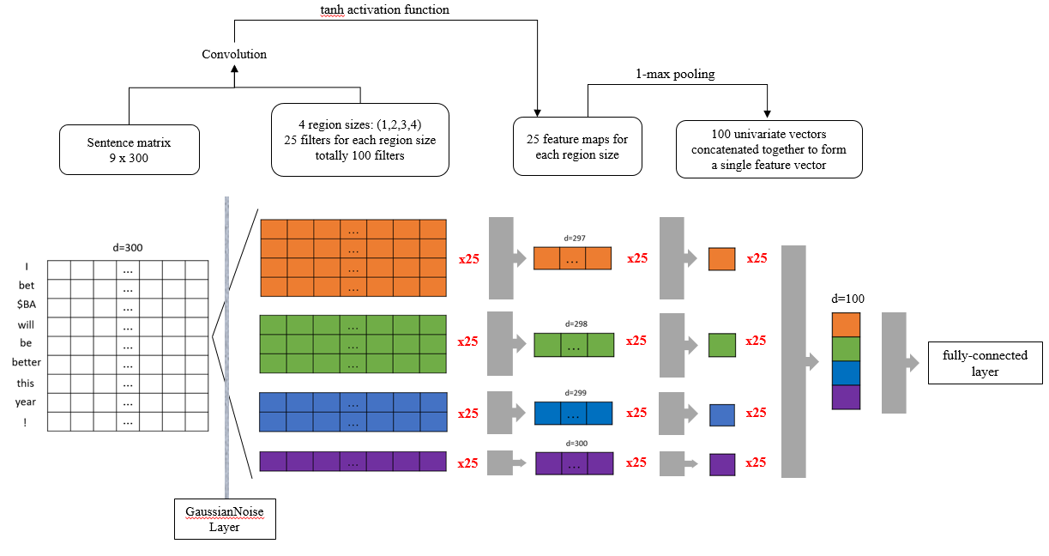
CNN Architecture Details (1)
Notes:
The architecture of CNN is divided into two, namely the feature-extraction and fully-connected network. The visualization of the feature-extraction network is shown in Fig. 2. First, the input of 300-dimensional sentence-embedding vector is passed into the Gaussian Noise layer. Then, four kind of convolution is slide over 1,2,3, and 4 word(s) at a time. For each type, we employ 25 such convolution, which means there are 100 convolutions in total. Note that the size 1 convolution outputs 300-dimensional vector, size 2 outputs 299-dimensional vector, size 3 outputs 298-dimensional vector, and size 4 outputs 297-dimensional vector. Third, the Tanh activation layer is performed on the convolution output. Fourth, a 1-max pooling is performed on each of the convolution output, which resulting in 100 of univariate vectors. Finally, those univariate vectors are concatenated to form a single 100-dimensional feature vector which is exploited as the input to the fully-connected network.

Slide 15
CNN Architecture Details (2)
Architecture Details & Hyper-parameters | CNN
Hidden Layers | 2
Nodes | 15, 15
Activation Function | Tanh for all layers
Dropout Layer | In each hidden layer (0.45 / 0.3)
L2 Regularization | In each hidden layer (0.008 / 0.05)
Epochs | 75
Batch Size | 32
Learning Rate | 0.0005
Optimizer | Adam
Loss Function | MSE
Notes:
Here we can see the architecture details of the fully-connected network for CNN.

Slide 16
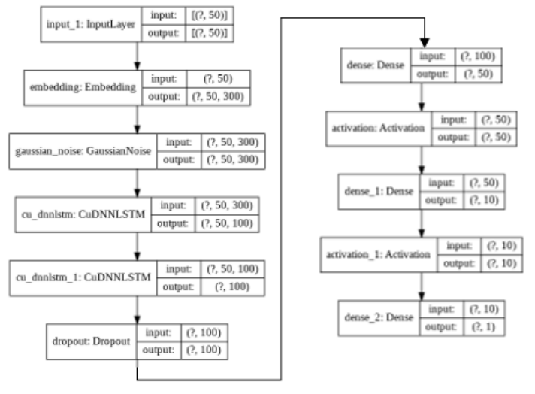
LSTM Architecture Details
ReLU
Tanh
Notes:
For LSTM, it consists of Gaussian Noise Layer which is performed after the input embedding layer and two LSTM layers with 100 units followed by DL, for both layer. Then, it is followed by the fully-connected network.

Slide 17
Stacked-Ensemble Architecture Details
MLP FD
Architecture Details & Hyper-parameters | Value
Hidden Layers | 1
Nodes | 4
Activation Function | ReLU for hidden layers, Tanh for output layer
Dropout Layer | 0.05
L2 Regularization | 0.02
Epochs | 300
Batch Size | 32
Learning Rate | 0.00075
Optimizer | Adam
Loss Function | MSE
relu
MLP SWE
relu
tanh
CNN
relu
LSTM
relu
Notes:
After all of the four models has been trained, we exploit the prediction result from those models as the input to the Stacked Ensemble model

Slide 18
Sentiment Score Extraction Performance
Model | Cosine Similarity
 | Average | Standard Deviation
MLP FD | 0.534 | 0.079
MLP SWE | 0.570 | 0.085
CNN | 0.574 | 0.064
LSTM | 0.546 | 0.084

Slide 19
How? - Detailed
Twitter and StockTwits microblog text data, annotated with sentiment score by financial experts
Prepared by SemEval-2017 challenge
Data Structure of Train 2 and Val 2. Value in the table is sentiment score
Data Train 1
(1162 rows)
MLP FD | MLP SWE | CNN | LSTM | Ground Truth
0,6 | 0,5 | 0,4 | 0,3 | 0,55
0,1 | -0,3 | -0,6 | -0,5 | -0,7
… | … | … | … | …
0,4 | 0,6 | 0,5 | 0,53 | 0,5
80%
Full Data
(1454 rows)
17%
Data Val 1
(247 rows)
Data Train 2
(247 rows)
3%
Data Test 1
(45 rows)
Data Val 2
(45 rows)
Notes:
So what data are we using to train our model? For sentiment score extraction part, we use the microblog text data, including Twitter and Stocktwits, which are annotated with sentiment score by financial experts. This data is prepared by SemEval-2017 challenge. (There is a total of 1454 texts in our corpus, with StockTwits data is ranging from 2011-2015 and Twitter is from March& April 2016.).
Now we will discuss about the data splitting methodology when training the sentimenct score extraction model. The full training data for sentiment score extraction is separated into three parts, namely train 1, validation 1, and test 1. Each of the MLP Feature Driven Model, MLP Simple Word Embedding, CNN, and LSTM is trained on the train 1 data using 10-folds cross-validation. Those four trained model will be used to predict both validation 1 and test 1 data. Thus, there are four prediction results for each the validation 1 and test 1 data. Then two new tables with five columns are created, each for validation 1 and test 1 data. Those columns consist of four predicted sentiment score results from the four trained models along with the actual sentiment score. The newly created table from validation 1 data will be exploited as the train data for the Stacked Ensemble model, namely train 2 data. While the newly created table from the test 1 data will be exploited as the validation data for the Stacked Ensemble model, namely validation 2 data.

Slide 20
How? - Detailed
Basic Features
Open Price, Low Price, High Price, Close Price, Volume
Stock Indicator Features
Bollinger Indicator, True Range, Simple Moving Average
Additional Features
Date, Time, Weekday, etc
Historical Stock Data Prediction
LSTM
LSTM
Stock Historical Data
Feature Engineering
Engineered Stock Historical Data
Notes:
Next is historical stock data prediction model which takes historical stock data as the input. A lot of effort is done on the feature engineering on the input variables. There are 3 groups of features created in the feature engineering phase: basic features, stock indicator features, and additional features. Basic features consist of the open, low, high, and close of the price, as well as the volume. Stock indicator features consist of the Simple Moving Average and some other indicators. Additional features consist of the date, time, weekday, etc. There are 22 features used in total for this historical stock data prediction part. Then the features created are exploited to the LSTM model.

Slide 21
How? - Detailed
SENN: Stock Ensemble-based Neural Network
Sentiment Score Extraction
Fusion Machine
MLP Feature Driven
MLP Simple Word Embedding
Microblog Text Data
Sentiment Score
Stacked Ensemble
CNN
Fully-connected Layers
LSTM
Ghosal et.al., “IITP at SemEval-2017 Task 5: An Ensemble of Deep Learning and Feature Based Models for Financial Sentiment Analysis,” in Proc. of the 11th International Workshop on Semantic Evaluation (SemEval-2017), 2017
Historical Stock Data Prediction
LSTM
LSTM
Stock Historical Data
Feature Engineering
Engineered Stock Historical Data
Notes:
The output from the historical stock prediction part are joined with the sentiment score extracted from the microblog text data, and then be exploited as the input to the fusion machine. The fusion machine basically is another MLP, which has a role as the prediction head of our overall model. The output of this prediction head is the predicted stock price.

Slide 22
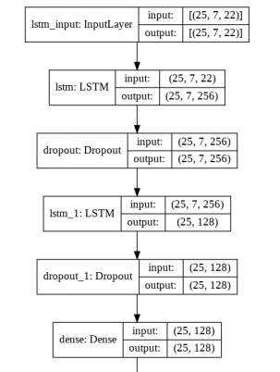
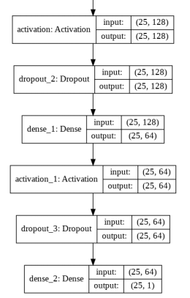
SENN Architecture Details
ReLU
ReLU
Notes:
We set the time-steps hyper-parameter q = 7. The model consists of 2 LSTM layers with 256 and 128 units followed by DL, respectively. A two-layered fully-connected network with 128 and 64 nodes in the first and second layer, respectively, is appended to the LSTM layers and takes four additional inputs from the microblog text data. The output layer consists of 1 node with a linear activation function. This model is trained with following settings: 275 epochs, 25 batch size, 0.0004 learning rate with Adam optimizer, and MSE loss function.

Slide 23
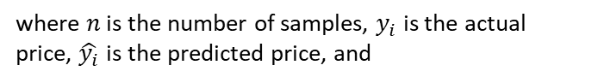
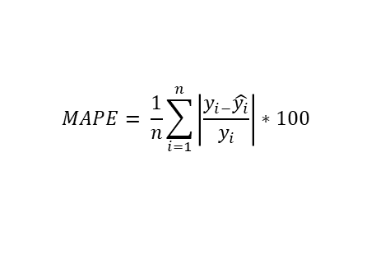
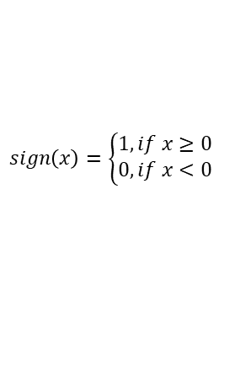
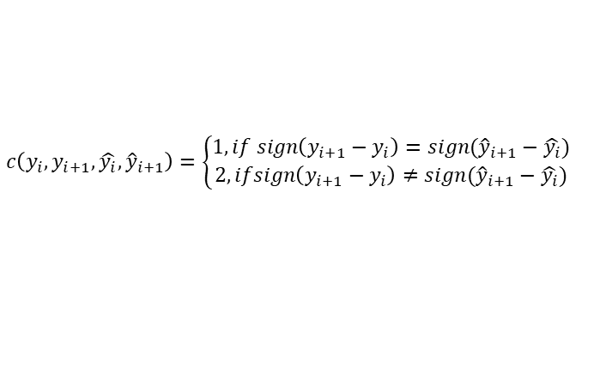
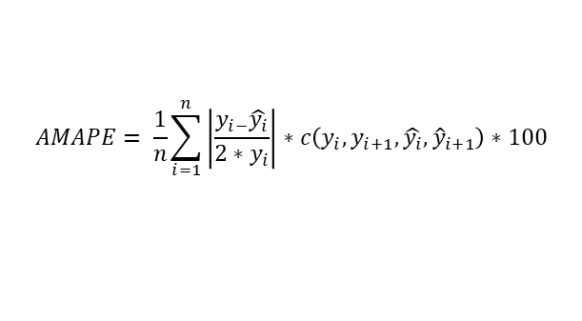
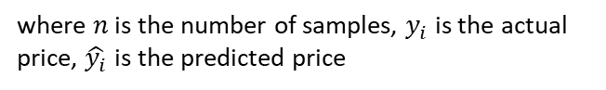
Evaluation Metrics
Regression problem
Mean Absolute Percentage Error (MAPE)
Does not take into account the “direction” of the prediction results
Adjusted MAPE (AMAPE): 2x penalty when the predicted price is in the wrong “direction”
$$MAPE= \frac{1}{n}\sum_{i=1}^{n}{\left|\frac{y_{i−}\hat{y_{i}}}{y_{i}}\right|∗100}$$
where $n$ is the number of samples, $y_{i}$ is the actual price, $\hat{y_{i}}$is the predicted price
$$AMAPE= \frac{1}{n}\sum_{i=1}^{n}{\left|\frac{y_{i−}\hat{y_{i}}}{{2∗y}_{i}}\right|∗c\left(y_{i},y_{i+1},\hat{y_{i}}, {\hat{y}}_{i+1}\right)∗100}$$
where $n$ is the number of samples, $y_{i}$ is the actual price, $\hat{y_{i}}$is the predicted price, and
$$c\left(y_{i},y_{i+1},\hat{y_{i}}, {\hat{y}}_{i+1}\right)=\left\{\begin{aligned}1, if sign\left(y_{i+1}−y_{i}\right)=sign({\hat{y}}_{i+1}−\hat{y_{i}}) \\ 2, ifsign\left(y_{i+1}−y_{i}\right)≠sign({\hat{y}}_{i+1}−\hat{y_{i}})\end{aligned}\right.$$
where
$$sign\left(x\right)=\left\{\begin{aligned}1,if x≥0 \\ 0,if x<0\end{aligned}\right.$$
Notes:
Since we treat the stock market prediction as the regression problem, MAPE (Mean Absolute Percentage Error) is the well-known metric can be used. However, this metric does not take into account the “direction” of the prediction results. To tackle that problem, we propose a novel way to measure the model performance in the stock market prediction task, namely Adjusted Mean Absolute Percentage Error (AMAPE). Intuitively, AMAPE will gives two times more penalty when the predicted price is in the wrong “direction” compared to when the predicted price is in the right “direction”.

Slide 24
Data
Most volatile stock in DJIA Index during 2019
Boeing Stock
1-hour lag time
Historical Stock Data -> Yahoo Finance API
Microblog Text Data -> StockTwits API
Notes:
So what are the data we are using to train our SENN model? First we get all of historical data from all of the 30 listed ticker in Dow Jones Index Average (DJIA) during 2019. Then we perform a segmentation to get the most volatile stock segment. The chosen stock ticker from that segmentation phase is Boeing ticker.

Slide 25

How to Choose the Most Volatile Stock Segment?
Hierarchical Clustering with Dynamic Time Warping
Applied on all of the 30 listed stock in DJIA
Metrics: Standard Deviation & Adjusted Volatility
$$Adjusted Volatility\left(S\right)=\frac{1}{K}\sum_{k=1}^{K}{\left(\frac{1}{N−1}\sum_{t=2}^{N}{\left|{po}_{k}\left(t\right)−{po}_{k}\left(t−1\right)\right|}\right)}$$
where K is number of entities in cluster S, N is the length of the time-series data, and po is defined as the stock opening price

Slide 26
Results
Average (Standard Deviation)
Historical Stock Data |  | SENN
AMAPE | MAPE | AMAPE | MAPE
1.188 (0.561) | 1.594 (0.721) | 0.890 (0.288) | 1.201 (0.361)
SENN outperforms the similar model which only exploits historical stock data as its input
Reduction of average AMAPE: ~ 25%
Reduction of AMAPE standard deviation: ~ 48%
Ratio between AMAPE and MAPE: 0.75 -> Quite good performance in “direction” wise.
Notes:
This table shows us the performance comparison measured by MAPE and AMAPE between the model that only exploit historical stock data as the input and our proposed SENN model which takes both historical stock data and microblog text data as the input to predict the stock price. We can clearly see there is around 25% reduction of average AMAPE followed by a large decrease of the standard deviation, that is around 48%. The reduction of average AMAPE shows that SENN succeeded to push down the prediction error which means that exploiting sentiment score as the additional input to the model succeeded to enhance the stock market prediction performance. The large reduction of standard deviation also shows that SENN is more confident in doing a prediction, compared to the model which exploits only historical stock data as its input. From the formula of MAPE and AMAPE, we can conclude that value of AMAPE divided by MAPE is bounded in the range [0.5, 1], where the infimum will be reach when all of the data points are predicted in the right “direction”, and the supremum will be reach in the other way around. Our results show that the ratio between AMAPE and MAPE for both historical stock data and SENN model is around 0.75. This means that both of them has a quite good performance in “direction” wise.

Slide 27
MAPE vs AMAPE
If we look closer to the results on previous Table, qualitatively, the newly proposed metric AMAPE shows the same behavior as the traditional MAPE with the difference only in their absolute value.
This could be due to our proposed model has a good performance with not many data points are predicted in the wrong “direction”.
On the other side, if the prediction model has a bad performance in “direction” wise, the AMAPE will be closer to the MAPE value.
Notes:
From the formula of MAPE and AMAPE, we can conclude that value of AMAPE divided by MAPE is bounded in the range [0.5, 1], where the infimum will be reach when all of the data points are predicted in the right “direction”, and the supremum will be reach in the other way around. Our results show that the ratio between AMAPE and MAPE for both historical stock data and SENN model is around 0.75. This means that both of them has a quite good performance in “direction” wise.

Slide 28
Key Takeaways
Combining Historical Stock Data, The Wisdom of Crowds, and Deep Learning to predict Stock Price
SENN: Stock Ensemble-based Neural Network
Adjusted Mean Absolute Percentage Error (AMAPE)
Notes:
So the key takeaways from this presentation is we succeed to combine historical stock data, the wisdom of crowds, and deep learning to predict stock price, by using SENN architecture. We also proposed a new metric for stock market prediction, namely AMAPE which also take into account the “direction” of the prediction results. Thank you for your time and interest with our paper! That’s all from me.

Slide 29
References
A. Picasso, et al. (2019). Technical analysis and sentiment embeddings for market trend prediction. Expert Systems with Applications, vol. 135, pp. 60-70.
D. Ghosal, et al. (2017). IITP at SemEval-2017 Task 5: An Ensemble of Deep Learning and Feature Based Models for Financial Sentiment Analysis. In Proc. of the 11th International Workshop on Semantic Evaluation (SemEval-2017), pp. 899-903
E. Al-Mansouri. (2016). Using Artificial Neural Networks and Sentiment Analysis to Predict Upward Movements in Stock Price. Tugas Akhir Sarjana, Departemen Ilmu Komputer, Worcester Polytechnic Institute, Worcester, Massachusetts.
G. Yoav. (2017). Neural Network Methods for Natural Language Processing. Toronto, Canada: Morgan & Claypool Publishers
Ian J. Goodfellow, et al. (2016). Deep Learning. Massachusetts, USA: MIT Press
M. Jiang, et al. (2017). ECNU at SemEval-2017 Task 5: An Ensemble of Regression Algorithms with Effective Features for FineGrained Sentiment Analysis in Financial Domain. In Proc. of the 11th International Workshop on Semantic Evaluation (SemEval2017), pp. 888-893.
M. Shastri, et al. (2018). Stock Price Prediction using Artificial Neural Model: An Application of Big Data. ICST Transactions on Scalable Information Systems, vol. 0, no. 0, p. 156085.

